Slide 1

AMAZON PRODUCT REVIEW
AKSHAY SUBRAMANYA AITHAL
RANGARAJ V
PUSHKAR BISWAS

Slide 2


INTRODUCTION
Amazon.com is the largest e-commerce platform in the world.
Amazon has 310 million customers worldwide.
Amazon sells 1.6 million package per day.
The amazon review dataset for Video Games was considered to help the business gain insights and make better business decision in the future.

Slide 3


OBJECTIVE
Gain important insights from the provided data and use it to provide business decisions.
To understand the sentiments of the reviews provided by the customers.
Optimize the inventory management by segmenting the products and forecasting future demand.
Recommending products to the user.
Segment the customers to understand their shopping behaviour.

Slide 4
TABLE OF CONTENT
Data Pre-processing
Data Exploration
EDA (Exploratory Data Analysis)
Sentiment and Text Analysis
Product Segmentation
Customer Segmentation
Collaborative Filtering
Forecasting with Time series
Conclusion
Business Propositions

Slide 5
PRE-PROCESSING & CLEANING
IMPORTATION
DATA EXPLORATION
MISSING/JUNK VALUE TREATMENT
FEATURE SELECTION
TEXT CLEANING
DUPLICATES VALUE TREATEMENT
FEATURE EXTRACTION
MERGING DATA
READY FOR EDA / MODELLING

Slide 6
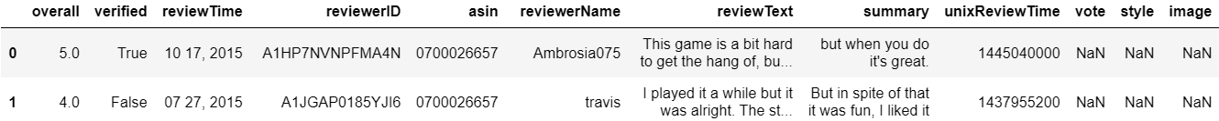
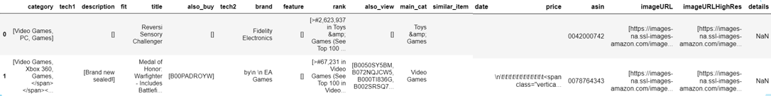

DATA EXPLORATION
MAIN DATA
META DATA
RATINGS DATA

Slide 7
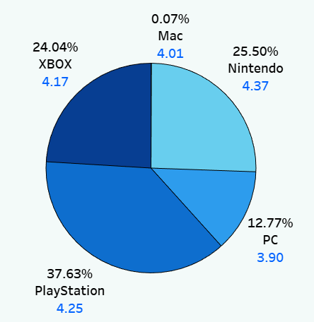
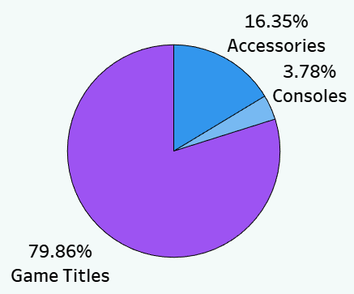
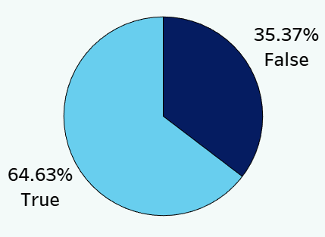
EXPLORATORY DATA ANALYSIS
SHARE OF DIFFERENT PLATFORMS
COUNT OF REVIEWS
PERCENTAGE OF VERIFIED REVIEWS

Slide 8
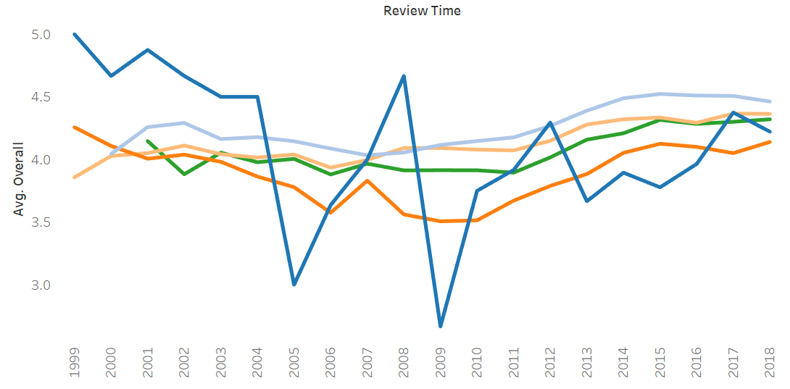
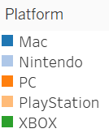
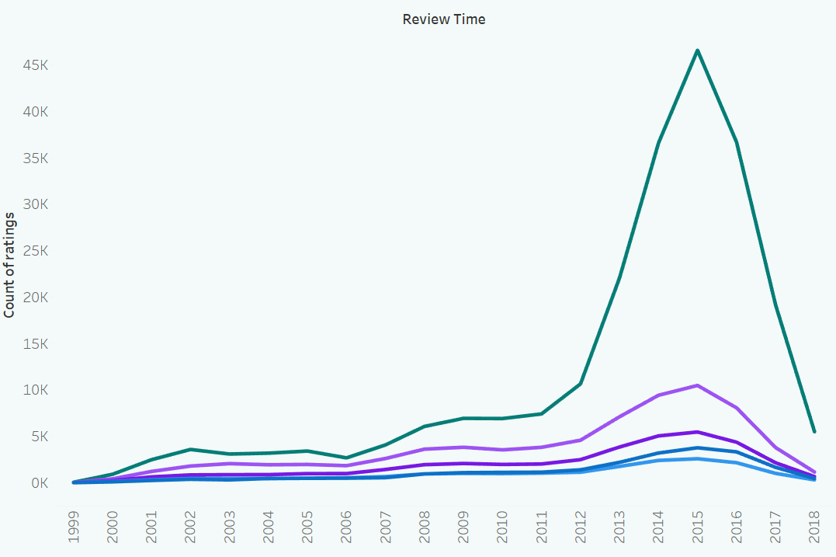

RATINGS DISTRIBUTION
Dashboard
RATINGS DISTRIBUTION FOR DIFFERENT PLATFORMS
RATINGS DISTRIBUTION OVER THE YEARS

Slide 9
SENTIMENT ANALYSIS
LANGUAGE DETECTION : Detecting non-English reviews with langdetect .
SENTIMENT ANALYSIS : To determine the underlying sentiment of a text.
VADER (Valence Aware Dictionary and sEntiment Reasoner)
REVIEW TEXT | SENTIMENT
“This game is a bit hard to get the hang of, but when you do it's great.” | POSITIVE
“I bought this and the key didn't work. It was a gift, and the recipient wasn't able to solve the problem. It might have been a good game, but I never found out because the key failed.” | NEGATIVE
“This game is way too easy for adults. For kids, it's great. I wish they made one for adults though with more difficulty levels.” | NEUTRAL

Slide 10
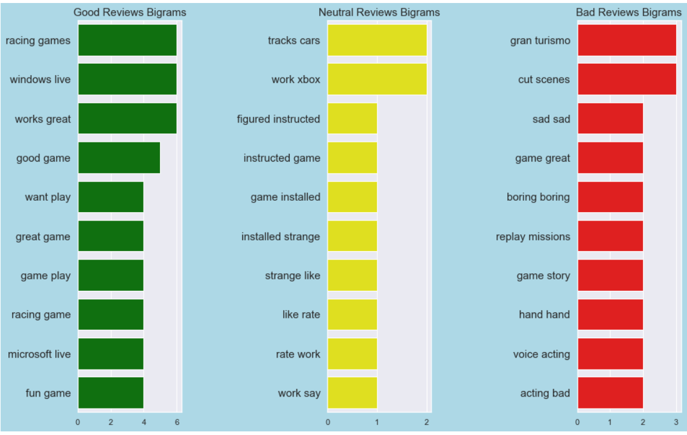
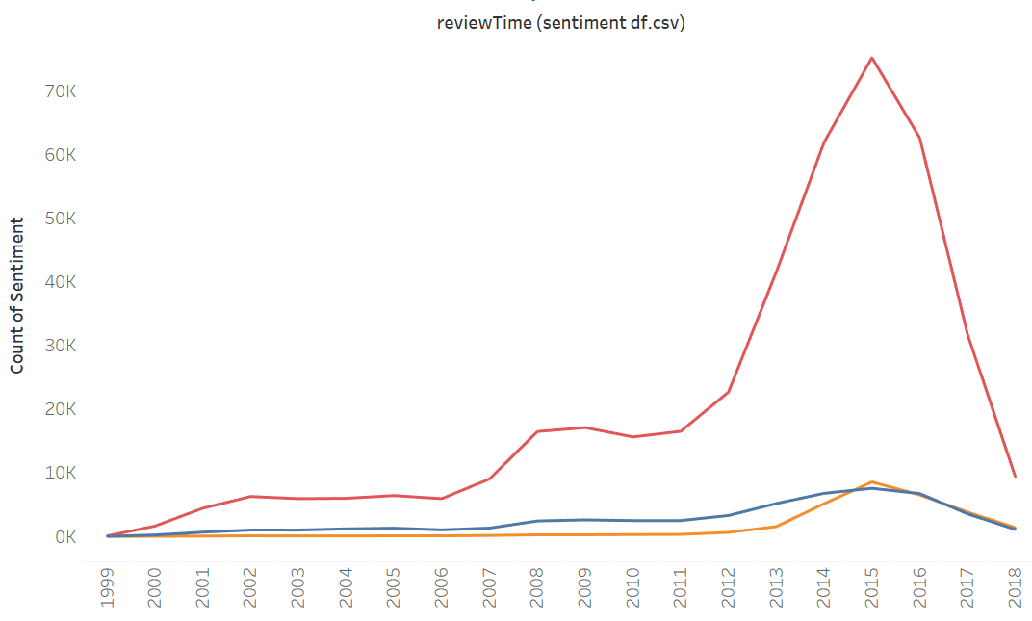
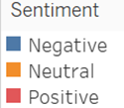
SENTIMENT ANALYSIS
Most frequent Bigram words
Distribution of sentiments over time

Slide 11
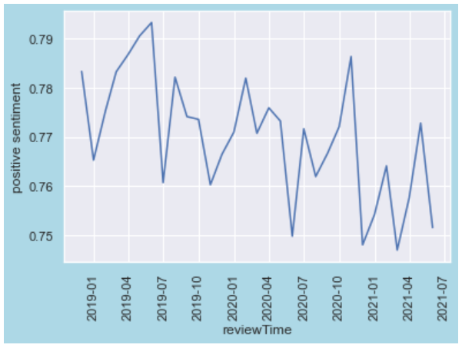
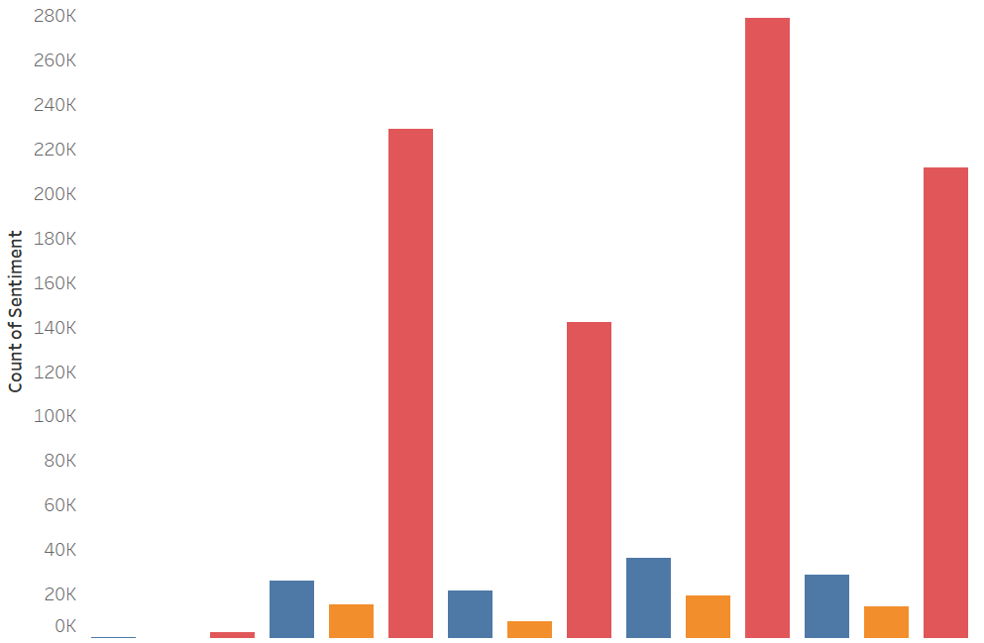
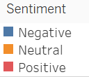
RATE OF POSITIVE SENTIMENTS (NEXT 30 WEEKS)
SENTIMENT DISTRIBUTION FOR PLATFORMS
forecasts
Rate of Positive Sentiment
MAC NINTENDO PC PLAYSTATION XBOX

Slide 12
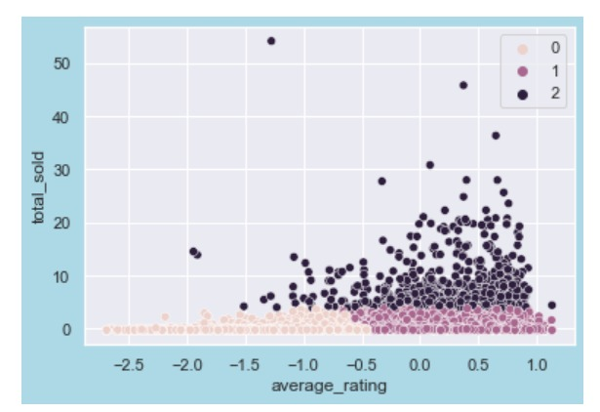

PRODUCT SEGMENTATION
SEGMENTATION OF PRODUCTS
Segmenting products to help with optimizing inventory.
Clustering based on average rating and total items sold for segmenting the products.
K-MEANS
Silhouette score : 0.56
AGGLOMERATIVE
Silhouette score : 0.43

Slide 13
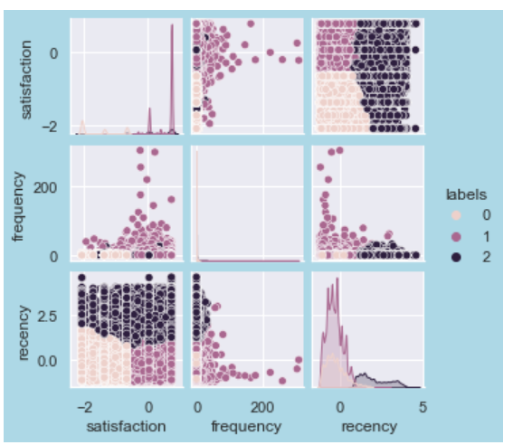
CUSTOMER SEGMENTATION
SEGEMENTATION OF CUSTOMERS
Segmenting customers to implement specific strategies on different category of customers.
Segmentation is done based on recency, frequency and satisfaction.
K-MEANS
Silhouette score : 0.51
AGGLOMERATIVE
Silhouette score : 0.41

Slide 14
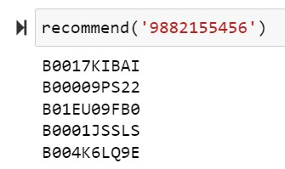
COLLABORATIVE FILTERING
Recommendation system to personalize the user experience and improve business outcomes.
Collaborative filtering is a method of making recommendations for items to users based on their past behavior and the behavior of other users.
An item-item recommendation system is a type of collaborative filtering approach that makes recommendations based on the similarity between items

Slide 15
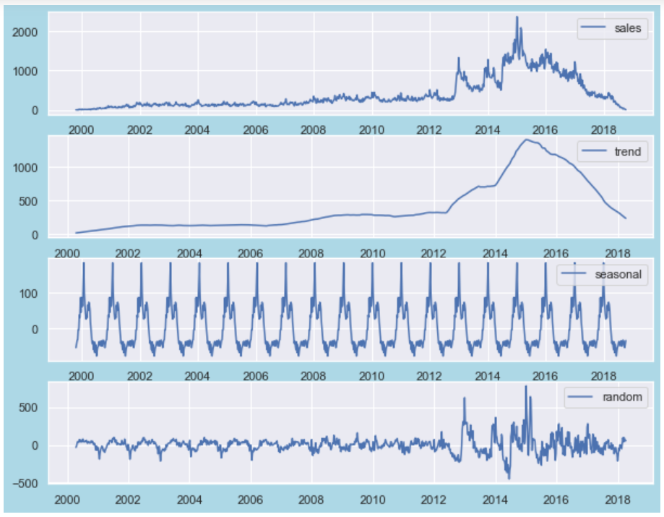
DEMAND FORECASTING
TIME SERIES COMPONENTS
Forecasting future demand to drive future strategic decision making.
SARIMA (Seasonal Auto Regressive Integrated Moving Average) is used for forecasting.
ITEMS SOLD

Slide 16
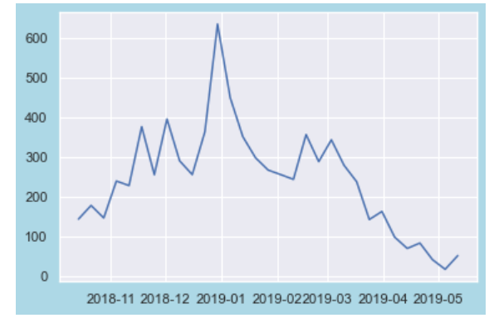
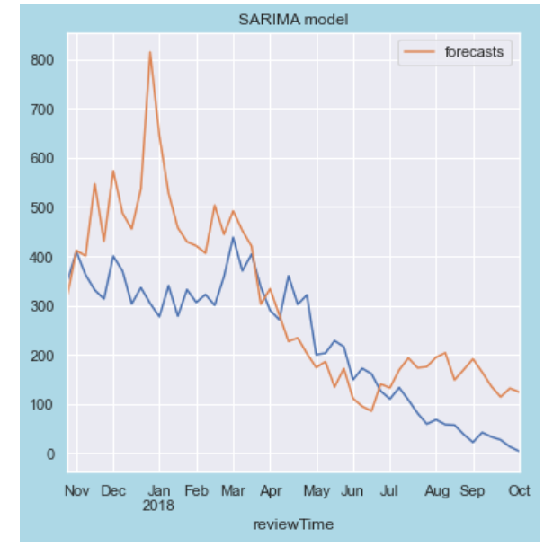
DEMAND FORECASTING
FORECAST FOR NEXT 10 WEEKS
ACTUAL VS PREDICTED ITEMS SOLD
forecasts
actual
ITEMS SOLD
ITEMS SOLD
reviewTime

Slide 17

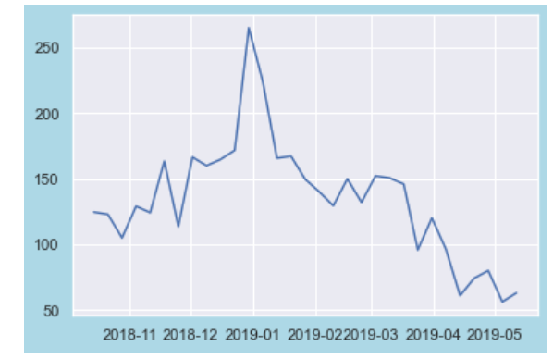
DEMAND FORECASTING ON UNDERRATED PRODUCTS
CLUSTERING OF PRODUCTS
FORECASTED SALES OF THE UNDERRATED PRODUCTS
0 : Not popular products
1 : Underrated Products
2 : Popular Products
forecasts
ITEMS SOLD

Slide 18
CONCLUSION
Possibility of fake reviews by the reviewers should be kept in mind as about 35% of the reviewer are non-verified customers.
People tend of give mostly Positive or 5-star reviews.
People are preferring digital copies from game distribution services.
Number of Underrated Products are quite high.
People tend to buys products near the holiday season.
From forecasting we can expect increase in demand in future 10 weeks.

Slide 19
BUSINESS PROPOSITIONS
Fake review monitoring system can be implemented.
Special deal or discounts can be promoted during the middle of the year to boosts sales.
Focus should shift towards digital copies of the games instead of physical disk.
Marketing campaigns maybe required for underrated products.
Man power should be adjusted according to the demand forecast.
Different strategies can be implemented according to customer behaviour.

Slide 20
Thank You
codebook

